Slide 1

Analysis and Design

Slide 2
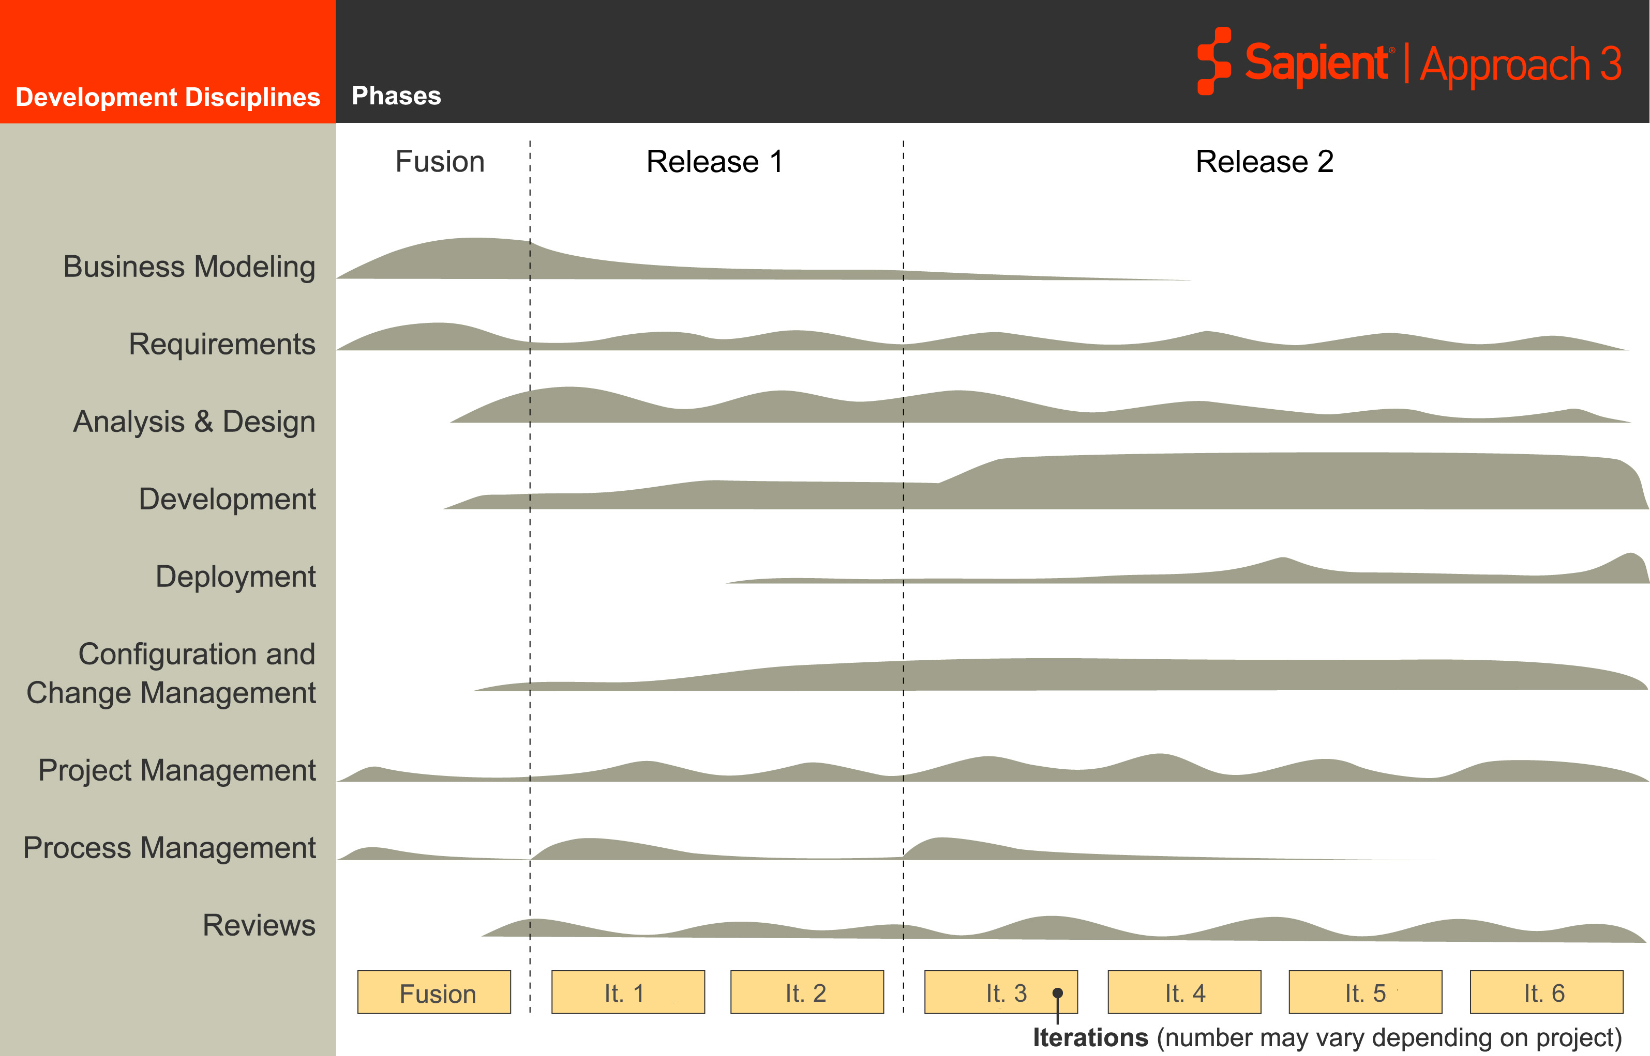
S|A 3 Project Life Cycle
Sapient|Approach 3
Fusion
EAR
Release 2
EAR
Analysis & Design
occurs throughout the project life cycle
Notes:
Speaker notes:
Analysis and design are activities that occur throughout the project. It is not a phase (which is how we think of design today).

Slide 3

Analysis and Design
Core concepts
Activities
Mandatory Artefacts

Slide 4
Core concepts
Refactoring
Done is done
Notes:
Speaker Notes:
Before we get on to the activities there are a couple of concepts we need to understand. Lets look at these two to start with.

Slide 5

Refactoring
“Refactoring is the process of changing a software system in such a way that it does not alter the external behaviour of the code yet improves its internal structure. It is a disciplined way to clean up code that minimises the chances of introducing bugs. In essence when you refactor you are improving the design of the code after it has been written.”
“As the cost of change lowers then you can do more of your design later as refactoring. Planned design does not go away completely, but there is now a balance of two design approaches to work with.”
Source: Martin Fowler
Notes:
Speaker notes:
Refactoring should be included as part of each story. This is something that each developer, but especially the Arch should be monitoring ie the quality of the code. If the Arch notices that alot of „crud“ has build up over time, then it may be necessary to include a refactoring story. However as a general rule, refactoring needs to ba accounted for throughout the development…not as an extra activity.

Slide 6
“Done is done”
Deliverables must be production-ready at the end of every iteration (no P1s or P2s)
No separate “clean up” phase
Forces decision making and closure on things of immediate concern
Need to leave time to do close-out within the iteration

Slide 7
Analysis and Design
Core concepts
Activities
Mandatory Artefacts

Slide 8
Analysis and Design Activities
Design Iteration Stories
Analyze Impact
Analysis & Design
Spike Solutions
Configuration Management
Manage Ongoing Design
Project Management
Development
Define System Architecture
Project Management
Requirements
Reviews

Slide 9

Design iteration stories
Purpose:
  Break down stories and create low level designs for each story that will be implemented during the iteration
Objectives
  Build team consensus around the implementation-level design for the current iteration's stories
  Develop the artefacts that will guide the development activities and allow multiple team members to work concurrently on each story
  Get input from each team member on design issues
Activities
  Choose a story to design and a facilitator.
  Compare the story with other stories that have already been implemented
  Facilitator Proposes an initial design
  Discuss and refine the design as a team until reaching consensus
  If no consensus is reached, agree on a set of next steps needed to finalise the design
Output:
  Shared vision/understanding of the way each story will be implemented
  List of tasks for each story

Slide 10
Analyse Impact
Purpose:
  Identify areas of an application impacted by change and assess the associated risk (most relevant for Manage projects)
Objectives:
  Performed to identify areas of a system impacted by changes and to assess the associated risk
  Aids in the prioritization, planning, implementation and deployment of the change in a manner consistent with business continuity requirements or other agreed Service Levels
  For scope changes, this activity facilitates the costing of the change
Activities:
  Qualify the nature and extent of change
  Identify key dependencies that will have to be met in order for the TAR to be implemented
  Assign an impact severity to the TAR
  Peer review the impact analysis
Outputs:
  Description of system impacts, risks captured in ResultSpace
Notes:
Speaker notes:
Point out again that this is mostly relevant for Manage projects.

Slide 11
Spike Solution
Purpose:
  The goal of a spike solution is for the team to build something for the primary purpose of learning
Objectives:
  Explore the nature of a potential solution
  Evaluate a particular technology or tool for inclusion in the final system
  Learn enough about an area of the application to be able to estimate it — “clearing the fog”
Activities:
  Define details and timebox
  Choose an individual to execute the spike (spikes are exploratory and are typically done by a single person)
  Implement as fast as possible - this is throwaway work.
  Report results to the team
  Throw away the code and other artefacts from the spike
  (the point is to learn)
Output:
  Increased knowledge

Slide 12

Manage Ongoing Design
Purpose:
  Ensure the integrity of the design is maintained as new stories are integrated so that future functionality can be accommodated
Objectives:
  Ensure that design of the system is being maintained and evolved daily
  Keep the design of the system as simple as possible, so that it is easy to change and can best accommodate future requirements
  Foster a common (team-wide) understanding of what constitutes clean, well-designed code, while educating team members about the principles of good design
Activities:
  Continuously monitor the code you are writing for opportunities to improve the design
  Continuously monitor code that is being developed within the track
    As stories are implemented, review the code to make sure that it contains no design problems
  Conduct refactoring meetings to teach the team members about good design principles and to model the level of quality that is acceptable
Output:
  Improved code with a better design
Notes:
Speaker notes:
This ties into the Refactoring concept. Ongoing design is critical to the success of this approach, and the quality of the design needs to be constantly monitored.

Slide 13
Define System Architecture
Purpose:
  Create and refine a broad “starting point” architecture
Objectives:
  Provide a high-level structure that serves as a starting point for the detailed design and development activities
  Capture and document the current understanding about the main physical components and logical abstractions of the system
  Discover and prioritise the major architectural and deployment issues that require further investigation
Activities:
  Create initial logical and physical system context diagrams
  Use the initial system context diagrams to identify unanswered questions
  As the system evolves (and consequently its design), update the system context diagram
    The number of unanswered questions will decrease over time and the architecture of the solution will stabilise
    Stabilisation of the system architecture is a critical step in finishing the Executable Architecture Release
Mandatory Artefacts:
  Logical and physical system context diagrams
Notes:
Speaker notes:
At the end of the EAR, you need to have a good cut at the physical and logical architecture. Since you will have built 10-20% of the application, and these are the high risk architecturally significant components, this is a good stable basis for building the application on. However as the system evolves, these too will require updates.

Slide 14
Analysis and Design
Core concepts
Activities
Mandatory Artefacts

Slide 15
Mandatory artefacts: Analysis and Design
System context diagrams
  Logical
  Deployment
Logical data model
Wireframes
Interface specifications
  External system interfaces
  Messages
Business and technical design models (as needed)
Sequence and other UML diagrams (as needed)

Slide 16
Questions?

